Slide 1
Spring MicroServices

Slide 2
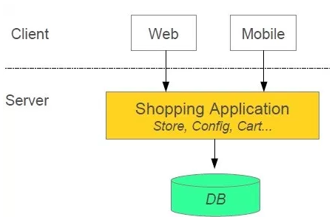
Shopping System without MicroService
In this architecture we are using Monolith architecture i.e. all collaborating components combine all in one application.
https://www.edureka.co/blog/what-is-microservices/

Slide 3
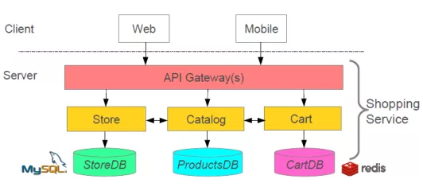
Advantages of MicroServices
Loose Coupling– Application build from collaboration services or processes, so any process change without effecting another processes.
Tight Cohesion-An individual service or process that deals with a single view of data.

Slide 4
What is MicroServices
The main objective of the micro-services implementation is to split up the application as separate service for each core and API service functionality and it should be deployed independently.
Microservices architecture allows to avoid monolith application for large system. It provide loose coupling between collaborating processes which running independently in different environments with tight cohesion.
Why MicroServices are Preferred?
We chose micro services architecture to write each functionality as a separate service for core and API functionality and it helps us to achieve the continuous delivery and integration.

Slide 5
Disadvantages of Monolithic System
Monolithic app services tend to get tightly coupled and entangled as the application evolves, making it difficult to isolate services for purposes such as independent scaling or code maintainability.
Monolithic architectures are also much harder to understand, because there may be dependencies, side-effects, and magic which are not obvious when you’re looking at a particular service or controller.
Interdependenies with other Team/s

Slide 6
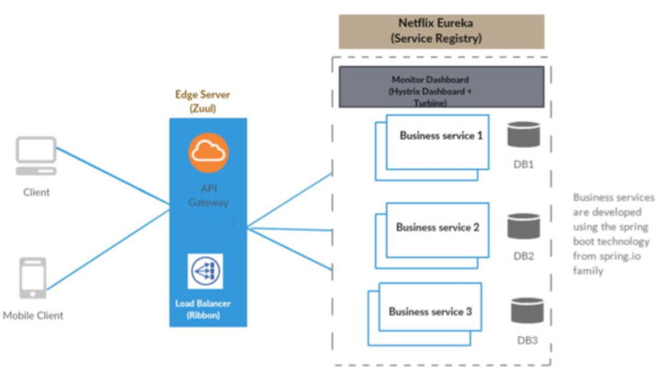
MicroServices Archietcture

Slide 7
Advantages
Microservices Benefits
Smaller code base is easy to maintain.
Easy to scale as individual component. And each MicroService can be scaled differently, based on the load it expects.
Technology diversity i.e. we can mix libraries, languages, databases, frameworks etc.
Fault isolation i.e. a process failure should not bring whole system down.
Better support for smaller and parallel team.
Independent deployment
Ease for Developer as a Developer need not have entire code base on a single IDE, he/she need to develop/change/build code of his service
Build/Deployment time reduce
Decentralized Governance
Release Cycle of each Microservice can be different
In production, it is certainly not the case- we break monolithic applications into microservice applications because we can scale each service based on the payload. A single instance of a service is unimaginable in production- so what we generally do is use a load balancer, which balances the payload among multiple instances of a service.

Slide 8
MicroServices - Implementation
Using Spring for creating Microservices
Setup new service by using Spring Boot
Expose resources via a RestController
Consume other Microservice services using RestTemplate
Each Microservice has certain specific purpose, and they interact with each other to perform a required functionality.

Slide 9
MicroServices - Implementation
Microservices – Deployment, Registry & Discovery
Generally Microservices are installed in multiple Nodes, and each MicroService may have multiple instances. This is to provide Horizontal scalability.
The problem due to this is how one MicroService can detect another MicroService, and the system where it runs, and on which all instances a MicroService runs.
This is termed as Service Registry and Discovery, there is a tool named Eureka for Service Discovery.

Slide 10
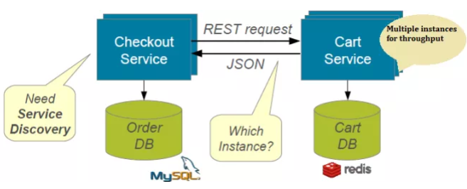
Without Discovery

Slide 11
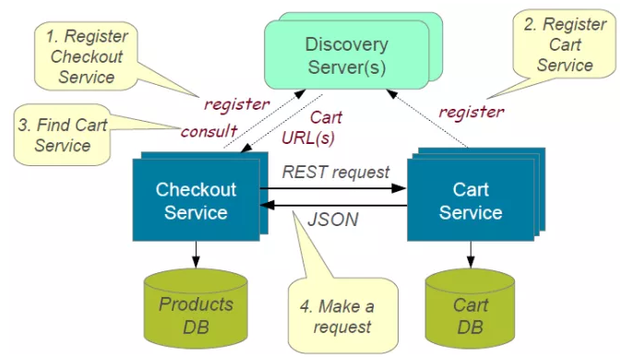
How Services Registry/Discovery works?

Slide 12
Advantages of Service Registry/Discovery
Microservices – Deployment, Registry & Discovery
Scalable - number of instances on which a Microservice can change, dynamically
Number of instances can change auto-scaling, failures, and Software/Hardware upgrades.
----
Eureka Client and Eureka Server(provided by Spring Cloud Netflix OSS) are used for Service Registry & Discovery

Slide 13
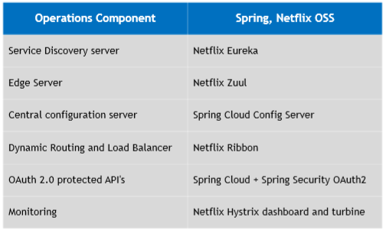
Netflix OSS Tools - MicroService Architecture
Below are Netflix OSS Tools used in MicroServices Architectures

Slide 14
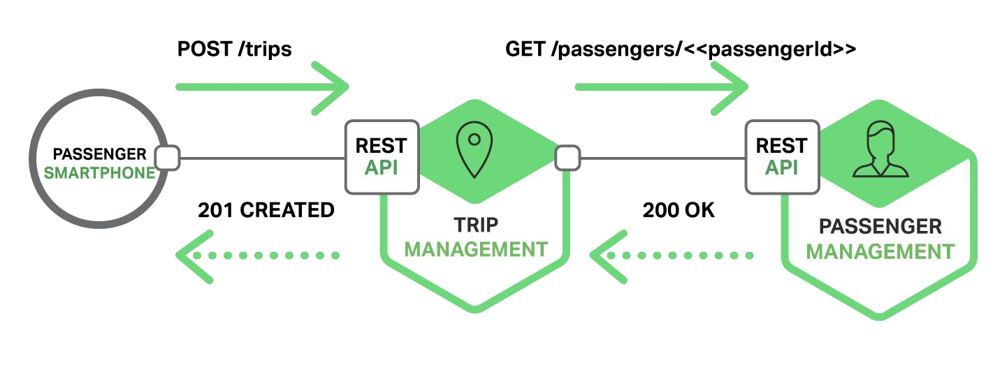
Traditional application
(without Service Registry/ Discovery)
To perform communication between services we need know the location of the service(port, host). In traditional applications it's a simple task because services run in a fixed and known location.

Slide 15
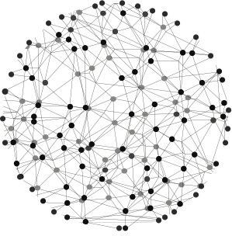
Modern application
In modern applications the services are running in a dynamic enviroment. A service can have N instances running in N different machines. In this case, to know host and port of each service manually is very painful.
Even though you know manually
that is subject to change, during run time.

Slide 16
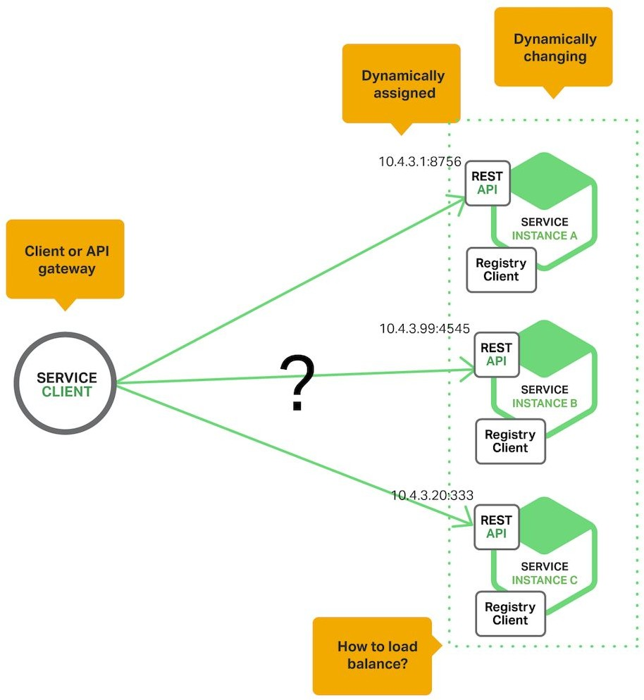
The problem

Slide 17
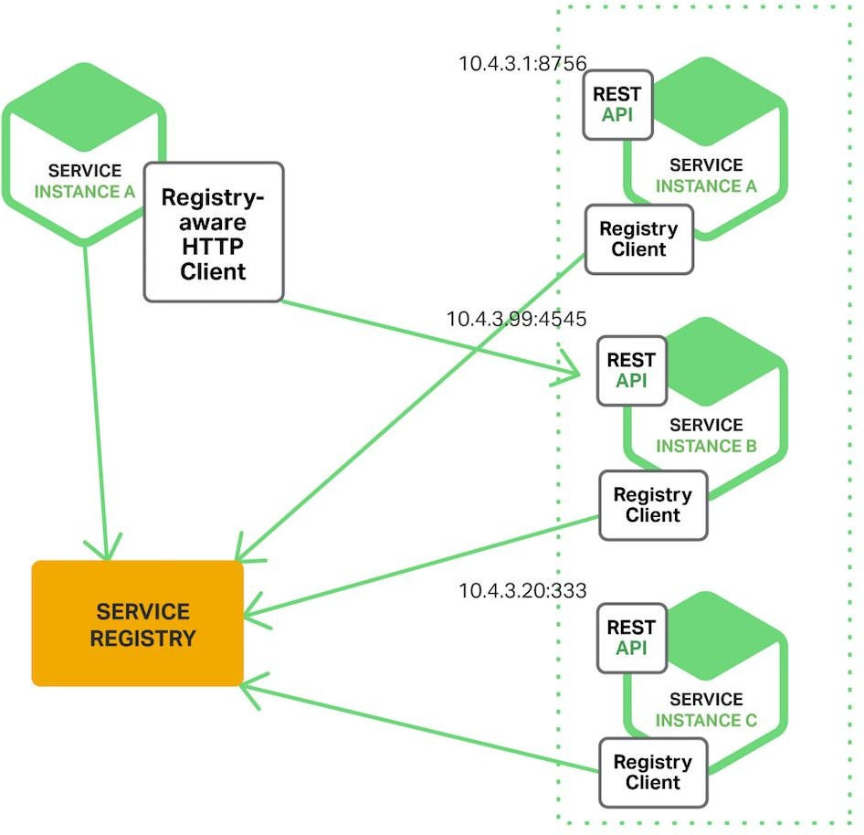
Service discovery

Slide 18
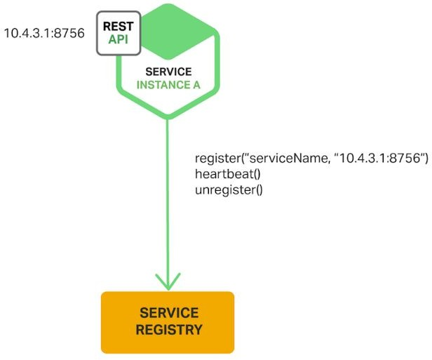
Service registry

Slide 19
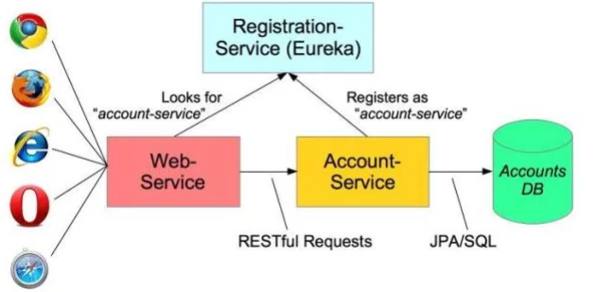
Eureka...
“Eureka is a REST (Representational State Transfer) based service that is primarily used in the AWS cloud for locating services for the purpose of load balancing and failover of middle-tier servers.”

Slide 20
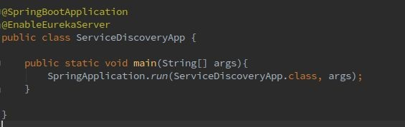
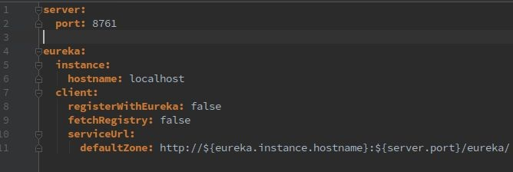
Eureka server with Spring Cloud configuration

Slide 21
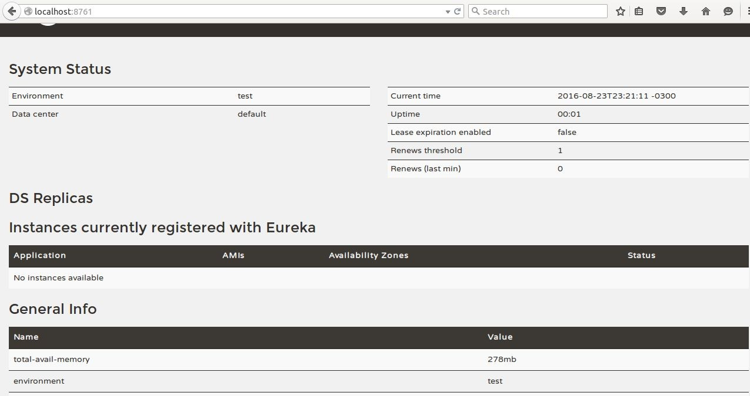
Eureka server dashboard

Slide 22
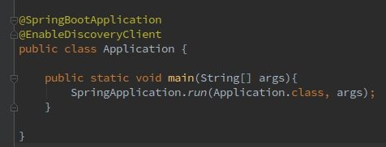
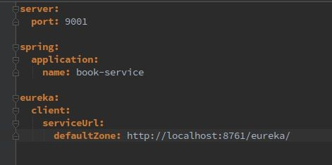
Eureka client configuration

Slide 23
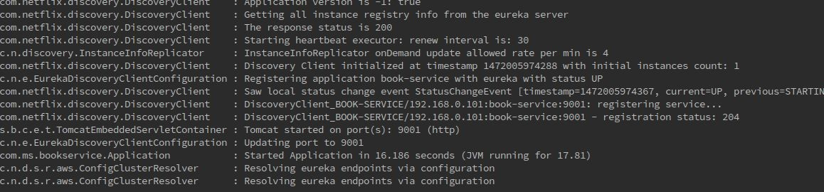
When you run the client application...

Slide 24
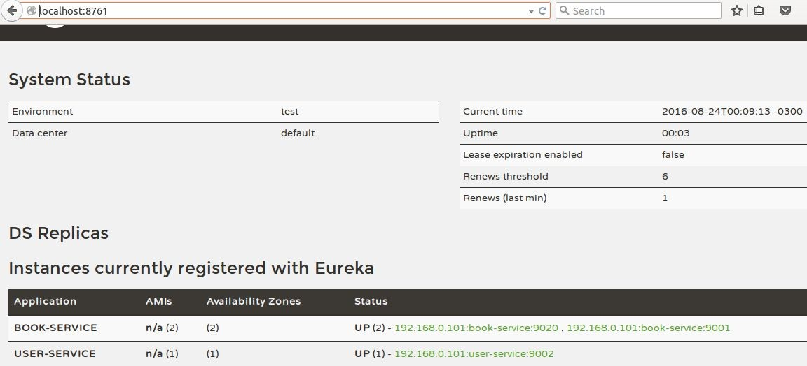
Show all instances registered

Slide 25
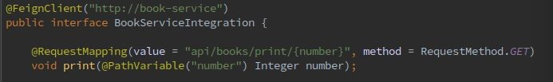
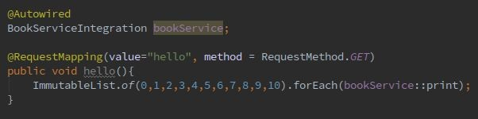
Consuming a service registered on Eureka

Slide 26
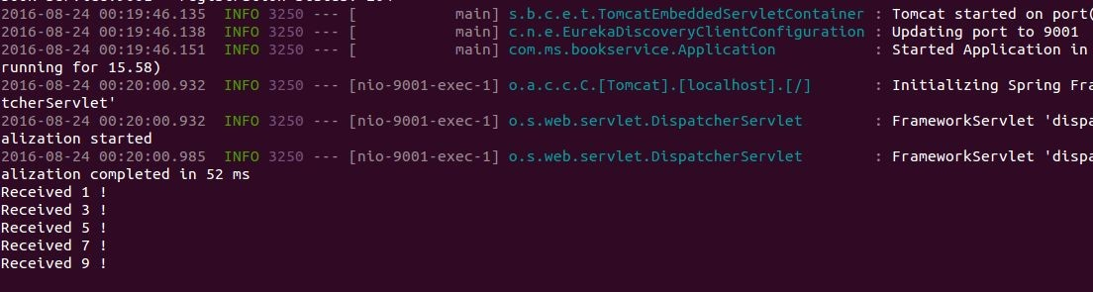
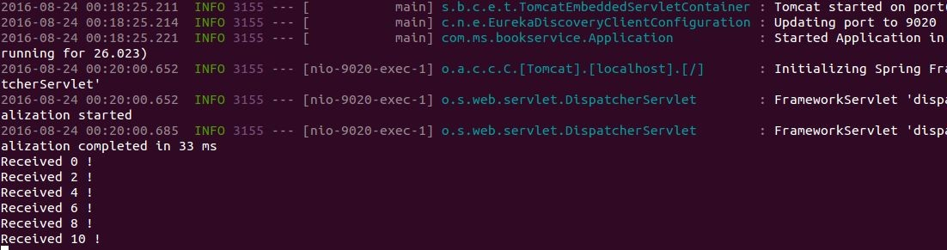
Load balancing request

Slide 27
What is Load Balancing?
Load Balancing is the mechanism in which the incoming requets need to get distributed among all available instances of a microservice.
This improves response time, and availability(when an instance does down during maintenance)
There are two types of Load Balancing Client side and Proxy Load Balancing.

Slide 28
Client Side Load Balancing
In Microservice environment we will be using Client Side Load Balancing Solution(Ribbon)
Client-side Load Balancing
Each service typically deployed as multiple instances for fault tolerance and load sharing. But there is problem how to decide which instance to use?
Implementing Client-Side Load Balancing
We will use Netflix Ribbon, it provide several algorithm for Client-Side Load Balancing. Spring provide smart RestTemplate for service discovery and load balancing by using @LoadBalanced annotation with RestTemplate instance.

Slide 29
Ribbon
Enable Ribbon in POM
<dependency>
<groupId>org.springframework.cloud</groupId>
<artifactId>spring-cloud-starter-ribbon</artifactId>
</dependency>
Enable Ribbon in Code @FeignClient(name="forex-service")
@RibbonClient(name="forex-service")
public interface CurrencyExchangeServiceProxy {
Configure the instances in application.properties:
forex-service.ribbon.listOfServers=localhost:8000,localhost:8001

Slide 30
Ribbon
Client side load balancing maintains an algorithm like round robin or zone specific, by which it can invoke instances of calling services.
The advantage is service registry always updates itself;
if one instance goes down, it removes it from its registry
so when the client side load balancer talks to the Eureka server, it always updates itself
so there is no manual intervention- unlike server side load balancing- to remove an instance.

Slide 31
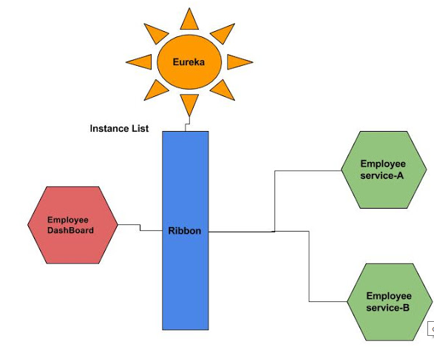
Ribbon

Slide 32
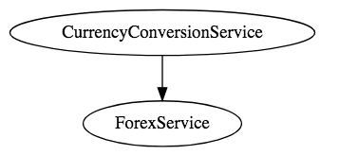
Client Side Load Balancing

Slide 33
Ribbon
Very Good overall reference:
https://bushkarl.gitbooks.io/spring-cloud/content/spring_cloud_security/more_detail.html
https://github.com/spring-cloud/spring-cloud-netflix/issues/2025
https://stackoverflow.com/questions/44402621/how-to-customize-the-ribbon-load-balancer-in-zuul-server

Slide 34
Load Balancing custom Configurations
an IClientConfig, which stores client configuration for a client or load balancer,
an ILoadBalancer, which represents a software load balancer,
a ServerList, which defines how to get a list of servers to choose from,
an IRule, which describes a load balancing strategy, and
an IPing, which says how periodic pings of a server are performed.
In our case above, the client is named say-hello. The properties we set are eureka.enabled (which we set to false), listOfServers, and ServerListRefreshInterval. Load balancers in Ribbon normally get their server lists from a Netflix Eureka service registry. (See the Service Registration and Discovery guide for information on using a Eureka service registry with Spring Cloud.) For our simple purposes here, we’re skipping Eureka, so we set the ribbon.eureka.enabled property to false and instead give Ribbon a static listOfServers. ServerListRefreshInterval is the interval, in milliseconds, between refreshes of Ribbon’s service list.

Slide 35
Client Side Load Balancing Custom Class
Custom Rule Definition
@Bean
@Scope("prototype")
public IRule ribbonRule() {
return new PickFirstLoadBalancerRule();
}
Pick First Load Balancer Rule
/**
* Chooses the first healthy instance in the list
*/
public class PickFirstLoadBalancerRule extends AbstractLoadBalancerRule {
@Override
public void initWithNiwsConfig(IClientConfig clientConfig) {
}
@Override
public Server choose(Object key) {
List<Server> upList = getLoadBalancer().getReachableServers();
//returns the first lb in the list every time
if (upList != null && upList.size() > 0) {
return upList.get(0);
}
return null;
}
}

Slide 36
Client Side Load Balancing Custom Class
Custom Rule Definition
@Bean
@Scope("prototype")
public IRule ribbonRule() {
return new PickFirstLoadBalancerRule();
}
Pick First Load Balancer Rule
/**
* Chooses the first healthy instance in the list
*/
public class PickFirstLoadBalancerRule extends AbstractLoadBalancerRule {
@Override
public void initWithNiwsConfig(IClientConfig clientConfig) {
}
@Override
public Server choose(Object key) {
List<Server> upList = getLoadBalancer().getReachableServers();
//returns the first lb in the list every time
if (upList != null && upList.size() > 0) {
return upList.get(0);
}
return null;
}
}

Slide 37
Feign Client
Netflix provides Feign as an abstraction over REST-based calls, by which microservices can communicate with each other, but developers don't have to bother about REST internal details.
Generally when one Service with other Service(Eg. EmployeeService,) we programmatically constructed the URL of the dependent microservice, then call the service using RestTemplate, so we need to be aware of the RestTemplate API to communicate with other microservices, which is certainly not part of our business logic.
Feign Client, which works on the declarative principle. We have to create an interface/contract, then Spring creates the original implementation on the fly, so a REST-based service call is abstracted from developers.
Not only that — if you want to customize the call, like encoding your request or decoding the response in a Custom Object, you can do it with Feign in a declarative way.
Feign, as a client, is an important tool for microservice developers to communicate with other microservices via Rest API.

Slide 38
Feign Client
Feign, a declarative HTTP client developed by Netflix.
Feign aims at simplifying HTTP API clients.
Simply put, the developer needs only to declare and annotate an interface while the actual implementation will be provisioned at runtime.
Step 1: Update POM.xml with feign dependencies
<dependency>
<groupId>org.springframework.cloud</groupId>
<artifactId>spring-cloud-starter-feign</artifactId>
</dependency>

Slide 39
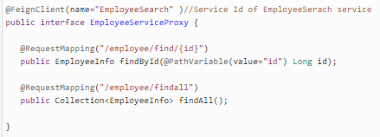
Now, we have to create an interface where we declare the services we want to call. Please note that Service Request mapping is same as the EmployeeSearch Service Rest URL. Feign will call this URL when we call the EmployeeDashBoard service. Feign dynamically generates the implementation of the interface we created, so Feign has to know which service to call beforehand. That's why we need to give a name for the interface, which is the {Service-Id} of EmployeeService. Now, Feign contacts the Eureka server with this Service Id, resolves the actual IP/hostname of the EmployeeService, and calls the URL provided in Request Mapping.
Feign Client

Slide 40
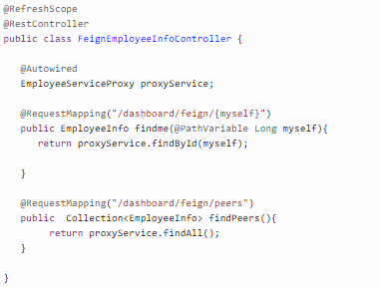
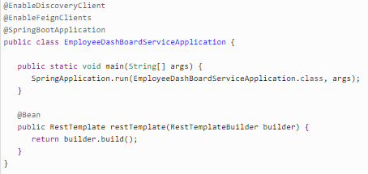
Step 3: Now we will create a FeignEmployeeInfoController where we autowire our Interface so Spring can Inject actual implementation during runtime. Then, we call that implementation to call the EmployeeService REST API.
Feign Client
Step 4: we need to tell our project that we will use Feign client, so scan its annotation. For this, we need to add the @EnableFeignClients annotation on top

Slide 41
Feign Client
Examples , below are steps
(Code available in https://drive.google.com/open?id=1CxVUCI4dKsheferXDzOUPYxIt_Xj9Ivf )
#1. Run Eureka Server com.doj.discovery Main Application
#2. Run com.myfeignn.client Main Application
#3. Run com.myfeignn.server Main Application
#4. Cross check if ports are given appropriately in all application.yml files
#5. Now. Give url in Browser http://localhost:4321/
Get content like below in Browser
Hello World: HelloServer:DESKTOP-V70EGBV:3333
Service Registry/Discovery
Eureka Server
Service Registry/Discovery
Browser
FeignClient
Server

Slide 42
Logs & Monitoring
We will use the @RequestLine annotation to specify the HTTP verb and a path part as argument, and the parameters will be modeled using the @Param annotation:
One of the most frequently mentioned challenges related to the creation of microservices-based architecture is monitoring. Each microservice should be run in an environment isolated from the other microservices so it does not share resources such as databases or log files with them.
Grepping the logs is not the right solution for that problem. There are some helpful tools that can be used when creating microservices with Spring Boot and Spring Cloud frameworks.
There are also some other tools — for example, Hystrix and Turbine — that provide real-time metrics for the requests processed by microservices.

Slide 43
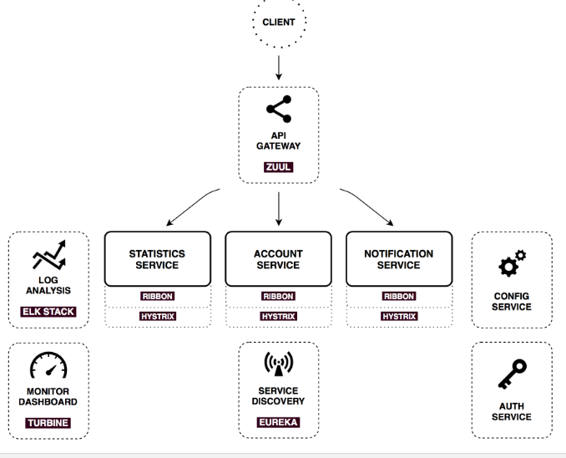
Logs & Monitoring

Slide 44
Hystrix
Netflix Hystrix has a neat feature called the Hystrix stream that provides real-time metrics on the state of the Hystrix commands in an application. This data tends to be raw though. A very cool interface called the Hystrix Dashboard consumes this raw data and presents a graphical information based on the underlying raw data:
Step 1: Add the Spring-Cloud-Starter-hystrix:
view sourc
<dependency>
<groupId>org.springframework.cloud</groupId>
<artifactId>spring-cloud-starter-hystrix</artifactId>
</dependency>
Step 2: Enable Hystrix support for the Application, this will expose the hystrix stream at a "/hystrix.stream" uri:
@SpringBootApplication
@EnableHystrix
public class SpringCloudApp {
public static void main(String[] args) {
SpringApplication.run(SpringCloudApp.class, args);
}
}
Now for the Hystrix Dashboard application to graphically view the Hystrix stream, the following annotation will enable that and the application should be available at "/hystrix" uri:
@SpringBootApplication

Slide 45
Hystrix
@SpringBootApplication
@EnableHystrixDashboard
public class AggregateApp {
public static void main(String[] args) {
SpringApplication.run(AggregateApp.class, args);
}
}

Slide 46
Turbine
<dependency>
<groupId>org.springframework.cloud</groupId>
<artifactId>spring-cloud-starter-turbine</artifactId>
<exclusions>
<exclusion>
<groupId>javax.servlet</groupId>
<artifactId>servlet-api</artifactId>
</exclusion>
</exclusions>
</dependency>
And to enable Turbine support in a Spring Boot based application:
Configurations for Turbine:
turbine:
aggregator:
clusterConfig: SAMPLE-HYSTRIX-AGGREGATE
appConfig: SAMPLE-HYSTRIX-AGGREGATE

Slide 47
Turbine
cluster is available at "/turbine.stream?cluster=SAMPLE-HYSTRIX-AGGREGATE" uri, it would figure out the instances of the cluster using Eureka, source the Hystrix stream from each instance and aggregat

